Slide 1


Rithvik Vinekar
22-Aug-2023

Slide 2

Outline
Executive Summary
Introduction
Methodology
Exploratory Data Analysis
Conclusion
Appendix
Dashboard
Predictive Analysis

Slide 3



Executive Summary
Methodology
Data from SpaceX launch and return was analyzed to build a model. The model can predict successful recovery of launch module after successful launch
Results
The results show that we have a model which shows an accuracy score of 88.75% in predicting the recovery of the launch module

Slide 4


Introduction
Most space launch vehicles which put satellites into orbit around the world are one-time use vehicles.
Due to this the cost of most launches are around $165 million or higher
However, SpaceX has pioneered reusable launchers. The first stage of these launchers return to earth after use and can be reused after landing successfully
Reuse of launcher vehicles brings down the cost of satellite launches. SpaceX can thus advertise a cost as low as $62 million per launch
However, not all launch vehicles successfully result in return of the first stage. Multiple factors complicate the successful landing and return of the launcher’s 1st stage.
We can analyse these factors and build a predictive model which will predict if a launch has the factors necessary to be reusable
This model can later be used to predict a reasonable cost for each type of satellite launch depending on their success rate

Slide 5

Section 1

Slide 6

Methodology
Executive Summary
Data collection methodology:
Data was collected using SpaceX APIs and Data scraping from Wikipedia
Perform data wrangling
The status string was classified as Success or Fail (1 or 0)
Perform exploratory data analysis (EDA) using visualization and SQL
Perform interactive visual analytics using Folium and Plotly Dash
Perform predictive analysis using classification models
Grid Search Cross Validation was performed for 4 different classification models to estimate the best parameters

Slide 7
Data Collection
Data was collected using two sources:
SpaceX API. Using the REST protocol, a JSON string was obtained containing requested data
Data Scraping : Wikipedia page on the launch status of SpaceX launches was scraped for information
The two data sources can be either combined or one of them used, as there is duplicated information. The REST method was preferred
Notes:
Data scaping process
Directly downloading data using API and json

Slide 8
Data Collection – SpaceX API
Spacex launch data is obtained from https://api.spacexdata.com/v4/launches/past as JSON data which is then converted to a dataframe
This dataframe has codes for rockets, launchpads, payloads and cores
The codes are used to obtain specific data, such as rockets from https://api.spacexdata.com/v4/rockets
This data from codes and launch data is combined, retaining only relevant fields
The data is cleaned for missing values and NULLs
For example, payload data which is missing is replaced by average payload
The notebook is available on github here:
launches
rockets
launchpads
payloads
cores
getBoosterVersion()
getLaunchSite()
getPayloadData()
getCodeData()
Get data function()
Data Processing
Data out
Data Cleaning
https://github.com/rsvinekar/Capstone-IBMDS/blob/main/01%20Data%20Collection%20API.ipynb
Data save as csv
Notes:
To add – github link

Slide 9
Data Collection - Scraping
Website data can be parsed
BeautifulSoup (BS4) library in python can be used
The html website is broken up into hierarchical elements by BS4
These are accessed in accordance with their level of nesting
Contents such as text within the html tags can be accessed as data
GitHub URL:
https://github.com/rsvinekar/Capstone-IBMDS/blob/main/02%20Data%20Collection%20webscraping.ipynb
request.get(website.url)
BeautifulSoup
Hierarchical decomposition
Query DOM elements

Slide 10
Data Scraping Logic
get HTML page
Parse data using BeautifulSoup
.find_all(table)[#]
In our case # was 2
BeautifulSoup breaks down the html data into tag elements
Tables will be in <table> element that can be located by .find_all(‘table’) to get an array of table(s)
If there are more than one table, they can be accessed as index to array, like .find_all(‘table’)[2] to get the 2nd element
Header row is the <th> element and header columns are under the <th> element as <td> elements
All other rows are under the <tr> element and <td> columns.
Nested loops for outer row<tr> and inner column<td>
Header Definition
Find child <th>
Find child <td>
Empty dataframe df
df header[Col]=text()
Col++
Row Definition
n
<td>++?
y
Find child <tr>
Column
Definition
Find child <td>
Col++
y
df[Row][Col]=text()
<td>++?
n
Row++
<tr>++?
dataframe df w/ data
y
n

Slide 11
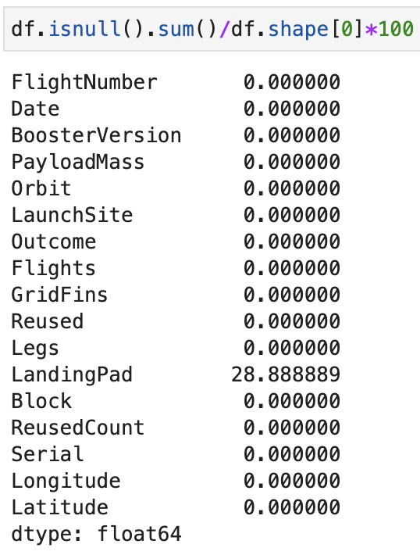
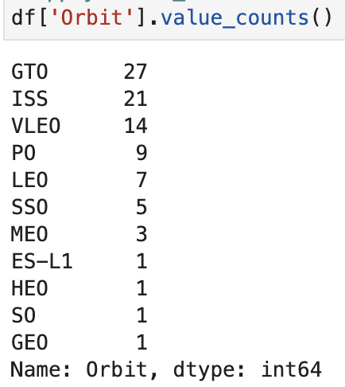
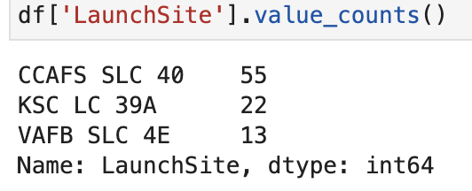
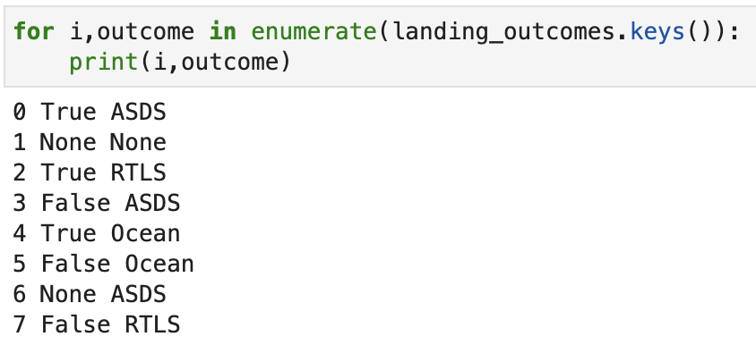
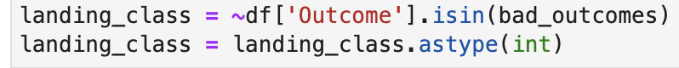
Data Wrangling
The data has NULL values
NULL values in Landing pad are removed
Orbital types
Calculate Number of launches on each site
Consolidate the mission outcome
Classify the mission outcome as a success (1) or failure(0)
1
3
2
4
5
Notes:
Since this is a course, the command is shown. Otherwise, this can be simply summarized as results, especially if this is presented.

Slide 12
EDA with Data Visualization
Exploratory data analysis was done to get trends or correlations:
Flight Number vs Launch Site
Payload vs Launch Site
Success Rate vs Orbit type
Flight Number vs Orbit type
Payload vs Orbit type
Launch Success Yearly trend
https://github.com/rsvinekar/Capstone-IBMDS/blob/main/05%20Exploratory%20Analysis.ipynb

Slide 13
EDA with SQL
Using bullet point format, summarize the SQL queries you performed
Add the GitHub URL of your completed EDA with SQL notebook, as an external reference and peer-review purpose
https://github.com/rsvinekar/Capstone-IBMDS/blob/main/03%20Database%20querying.ipynb

Slide 14
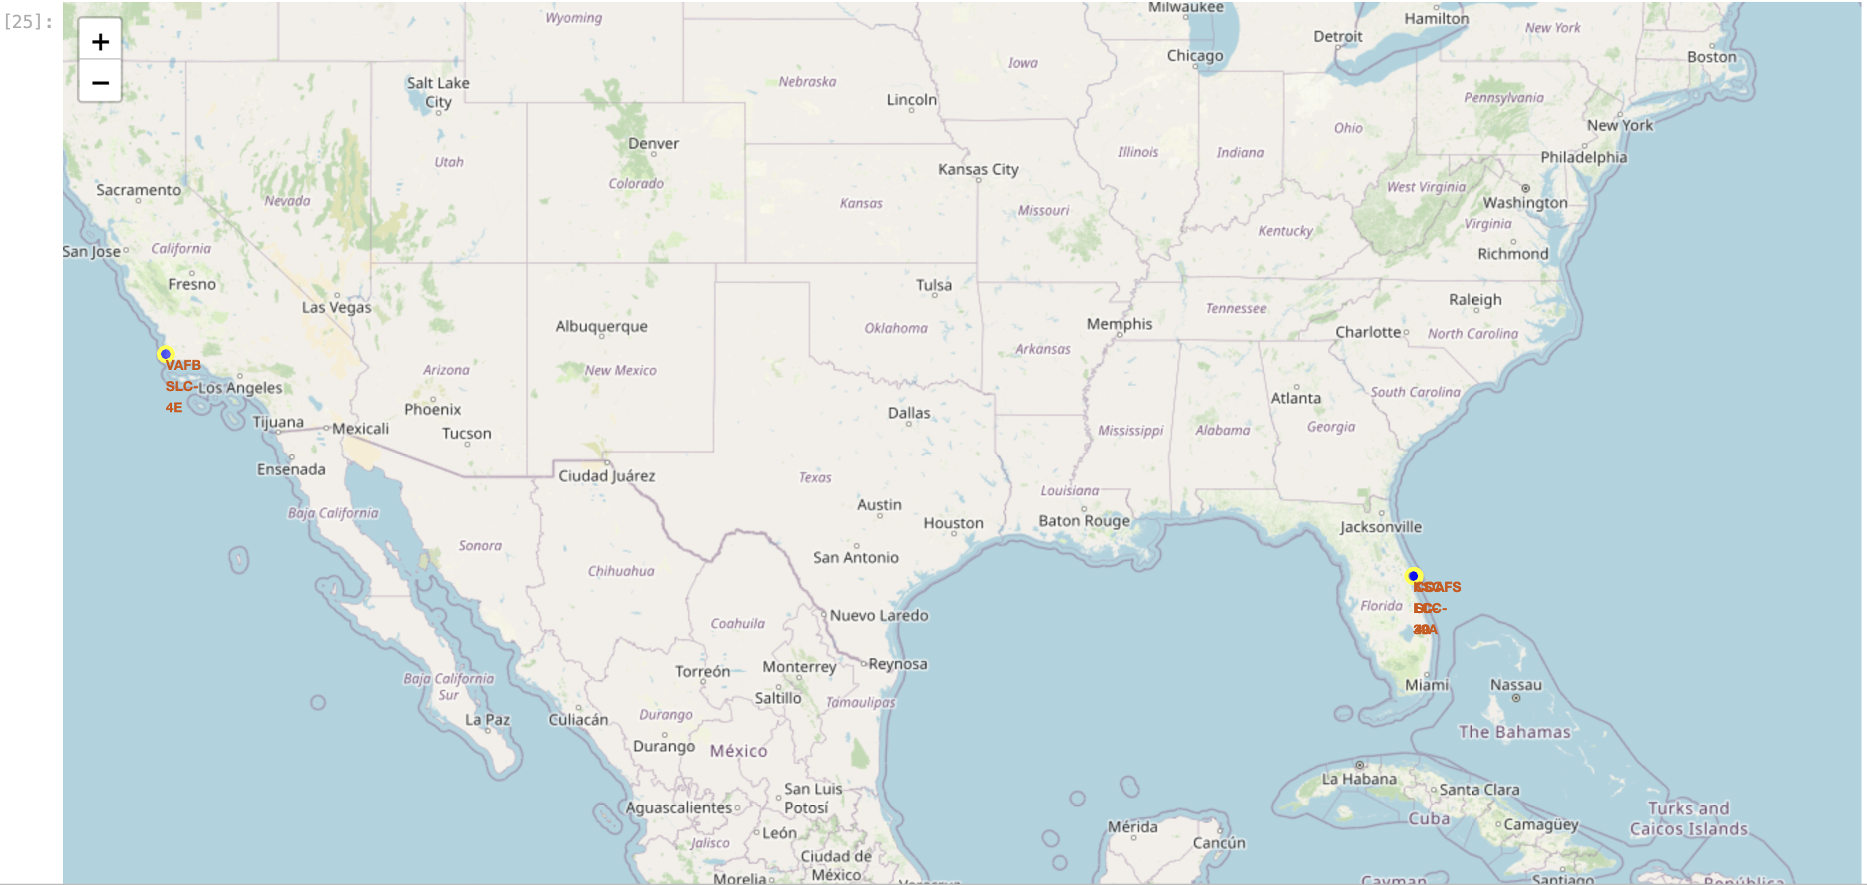
An Interactive Map with Folium
A Map is made using Folium shows the following points:
Icon added, which shows name of the Launch site
CircleMarker for each Launch site
MarkerCluster to add number for each launch site
Colored Icons with success or failure status
Polyline to mark nearest coast line, road, rail and major city
Distance measures added as icon for these points
https://github.com/rsvinekar/Capstone-IBMDS/blob/main/06%20Maps%20with%20Folium.ipynb

Slide 15
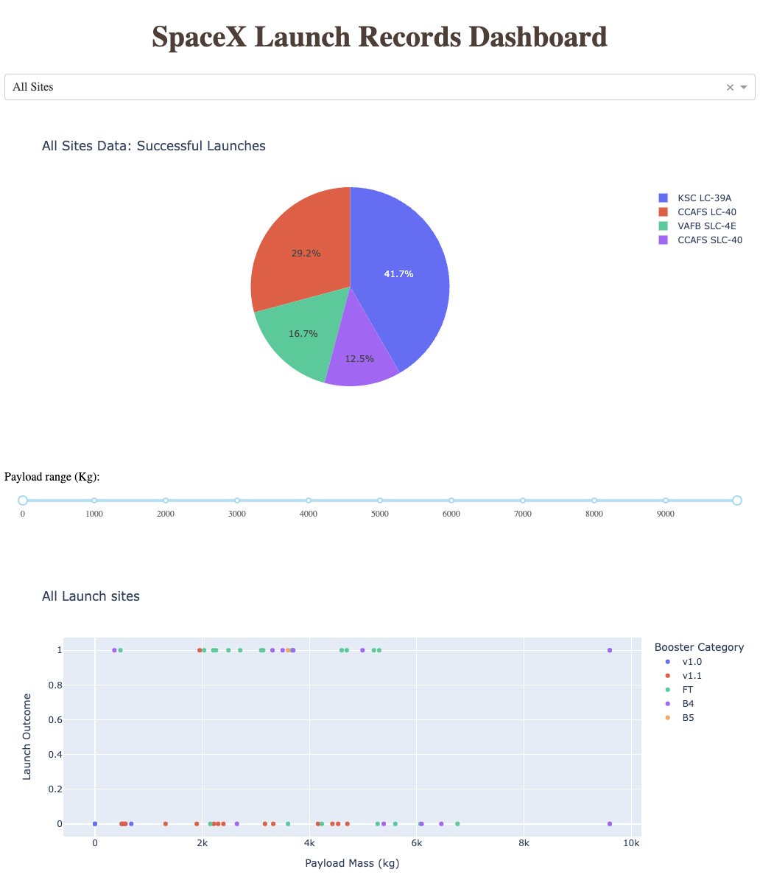
Dashboard with Plotly Dash
The Dashboard is provided which runs with python and dash
The dashboard has two charts
A pie chart. A dropdown to choose the Launch site is provided. For Option “All Sites”, it provides a summary of success rates of all sites. Specific sites give success vs failure rate.
A scatter plot of Success rate vs Failure of landing vs payload. A Range slider for payload selection is provided
The app link is provided below:
https://github.com/rsvinekar/Capstone-IBMDS/blob/main/spacex_dash_app_dash1.py
Also, please check the Appendix for more details

Slide 16
Data
Predictive Analysis (Classification)
Data + Dummies (X)
Class (Y)
Landing status was interpreted into a class variable (0 or 1 for failure or success) and the data was converted into dummy variables for machine learning
Four different models for machine learning were used to predict the class variable from the other variables available to us. The best parameters were chosen using GridSearch cross validation for each model
Four models were tried:
logistic regression (logreg)
Support vector machine (svm)
Decision trees (tree)
K-nearest neighbours (knn)
The optimal parameters were determined using Grid Search Cross Validation (GridSearchCV)
Choose Model
GridSearchCV parameters
Next Model
Accuracy score
Score comparison

Slide 17

Results
Exploratory data analysis results
Interactive analytics demo in screenshots
Predictive analysis results

Slide 18

Section 2

Slide 19
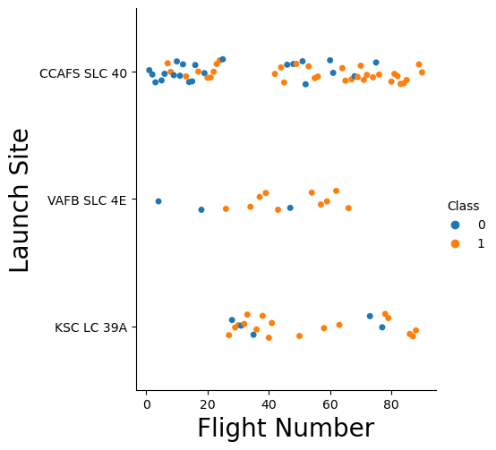
Flight Number vs. Launch Site
This graph shows the launch sites and the flight numbers, which are roughly correlated with time
The color is according to landing outcome
Class 0 is failure, class 1 is success for landing outcome.
In some cases, there was no landing attempted. Here the class is 0 but the mission was successful
We can see the site CCAFS SLC 40 having the highest number of flights
Note that in these graphs CCAFS LC 40 and CCAFS SLC 40 refer to the same launch site labeled CCAFS SLC 40, as they are geographically at nearly the same location
KSC LC 39A site has flight numbers from ~30 onwards

Slide 20
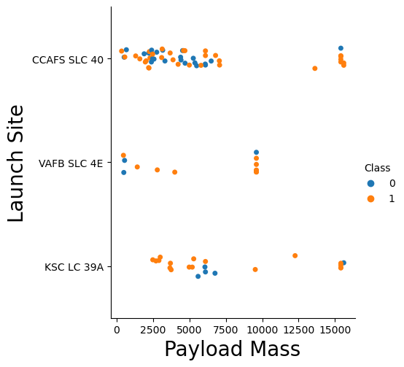
Payload vs. Launch Site
Most trials are for low payload mass
VAFB SLC 4E is not used to launch high payload missions

Slide 21
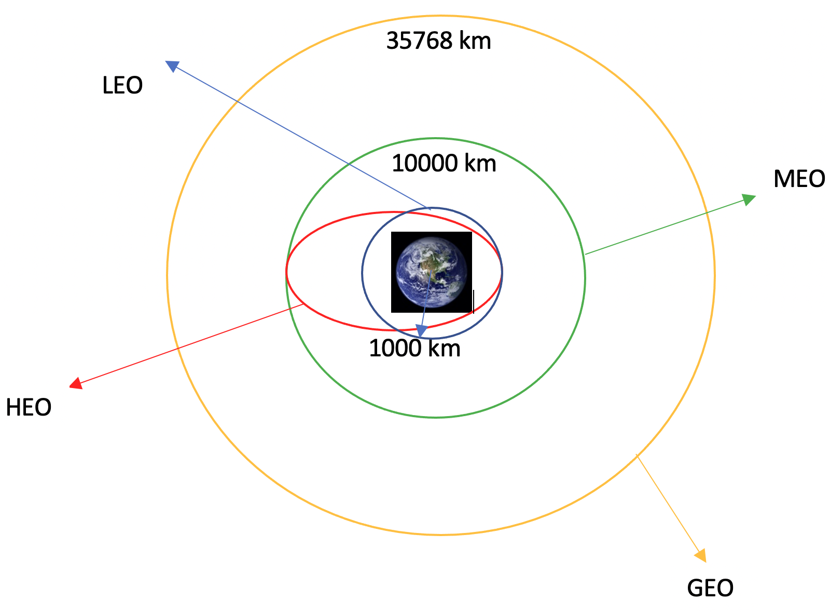
Orbit Type
LEO: Low Earth orbit
VLEO: Very Low Earth Orbits
GTO Geosynchronous orbit
SSO (or SO): Sun-synchronous
ES-L1 : L1, the first Lagrangian Point
HEO A highly elliptical orbit
ISS - International Space station
MEO Geocentric Medium earth orbits
HEO Geocentric orbits High Earth orbit
GEO Circular geosynchronous orbit
PO Polar orbit

Slide 22
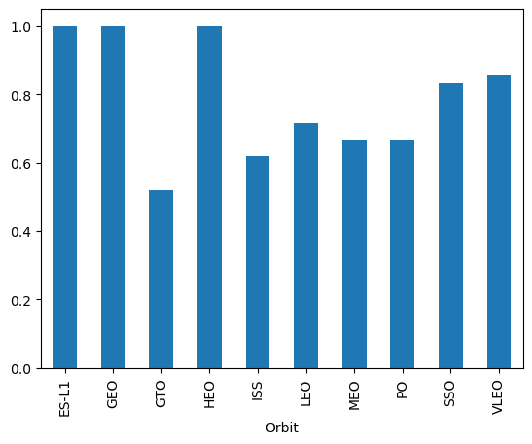
Success Rate vs. Orbit Type
There is a very high chance of success for geosynchronous orbits
There was only one attempt at an SO orbit, which failed
Launch missions labelled SSO were all successful, and there were 5 such attempts
Thus, with SO and SSO combined, the success rate is 0.83 and the SO term is removed

Slide 23
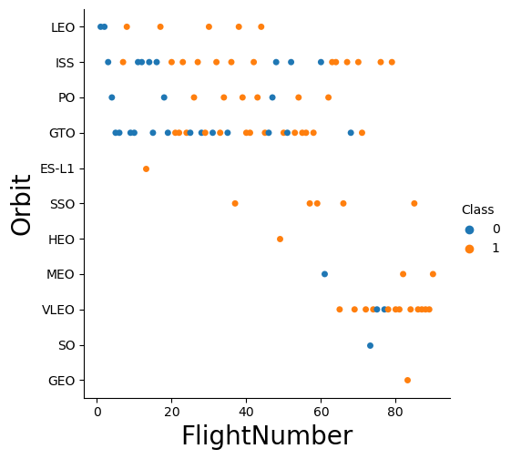
Flight Number vs. Orbit Type
This graph shows the Launch attempts over time by flight number
A number of launches were made for LEO, ISS, PO and GTO in the early phases
SSO and SO are taken as the same, so there is one failure reported for SO and 5 successes for SSO
The success rate is progressively improving as after flightnumber 75, there are no failures reported

Slide 24
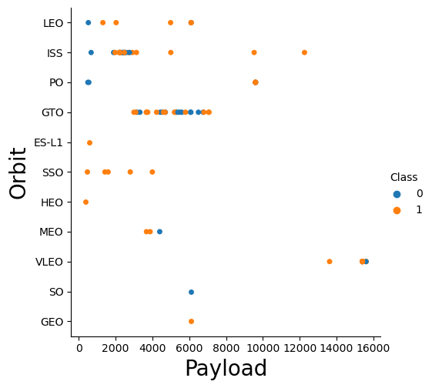
Payload vs. Orbit Type
The graph shows payload vs orbit type
Landing attempts are successful across different payload values

Slide 25
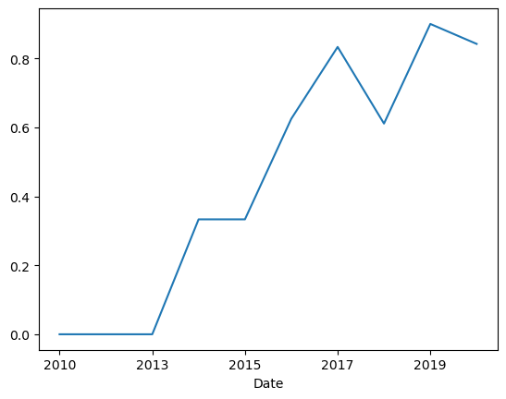
Launch Success Yearly Trend
Show a line chart of yearly average success rate
The Yearly Average success rate increased steadily from 2013 to 2017 as experience with launches increased
Dips in success rate may be attributed to testing of newer next gen technology

Slide 26
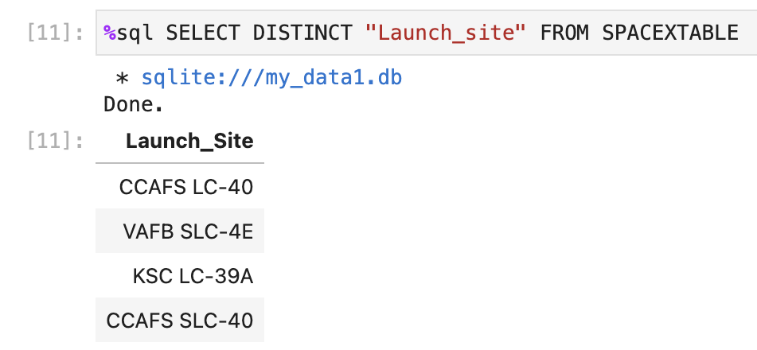
All Launch Site Names
The Launch sites have the following names:
CCAFS LC-40
VAFB SLC-4E
KSC LC-39A
CCAFS SLC-40
We can do this with SQL Queries.
The dataframe is loaded into an SQLite database and queries are run. In most graphic visualizations above, CCAFS LC-40 and CCAFS SLC-40 have been combined, as their geographic location is within the same complex

Slide 27
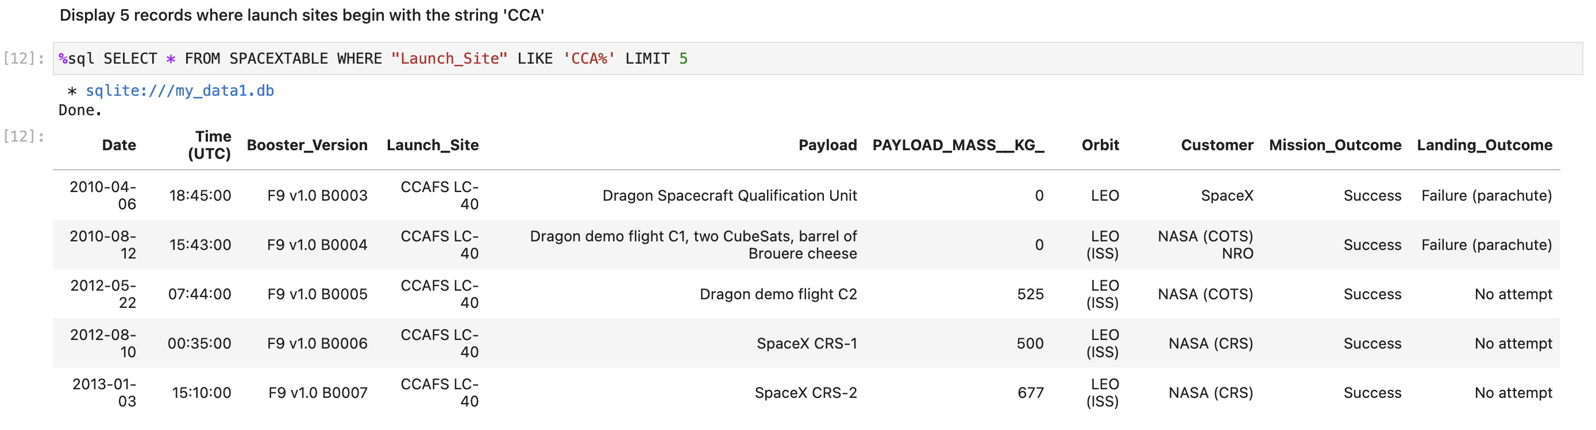
Launch Site Names Begin with 'CCA'
There are two launch sites beginning with CCA. We can look at a sample of the data from these launch sites. We can see the customer being either SpaceX or NASA

Slide 28
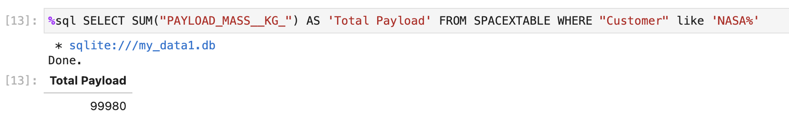
Total Payload Mass
The total payload carried by boosters for NASA is 99980 kg

Slide 29
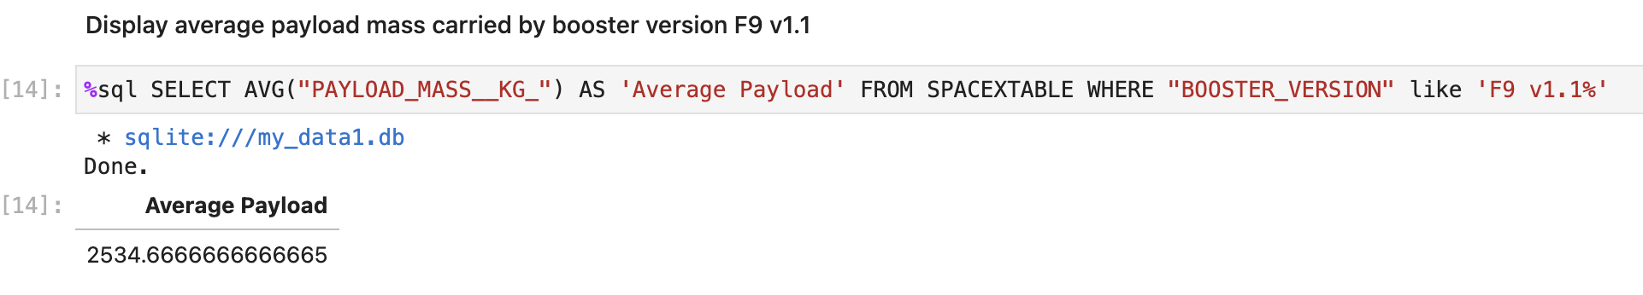
Average Payload Mass by F9 v1.1
The average payload mass carried by booster version F9 v1.1
The average is 2534.66 kg

Slide 30
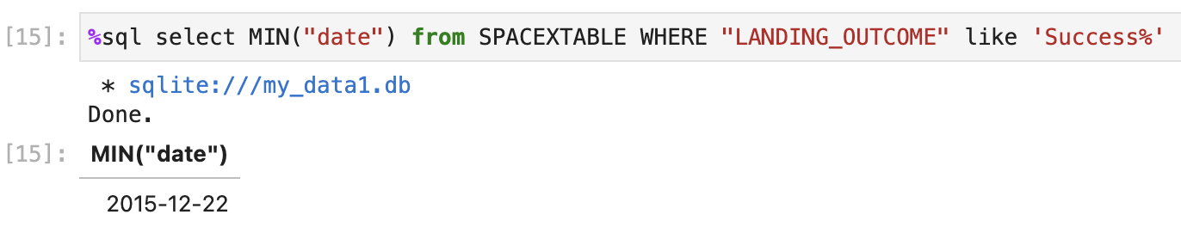
First Successful Ground Landing Date
The first successful Ground landing was done on 12-12-2015

Slide 31
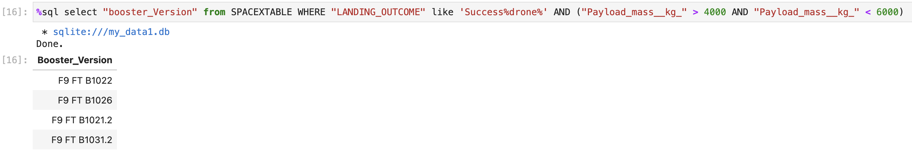
Successful Drone Ship Landing with Payload between 4000 and 6000
This provides the names of boosters which have successfully landed on drone ship and had payload mass greater than 4000 but less than 6000
The WHERE clause uses two Boolean parts, LANDING_OUTCOME starting with Success and a Boolean operation with Payload_mass_kg < 4000 and <6000. The BETWEEN _ AND _ clause can also be used

Slide 32
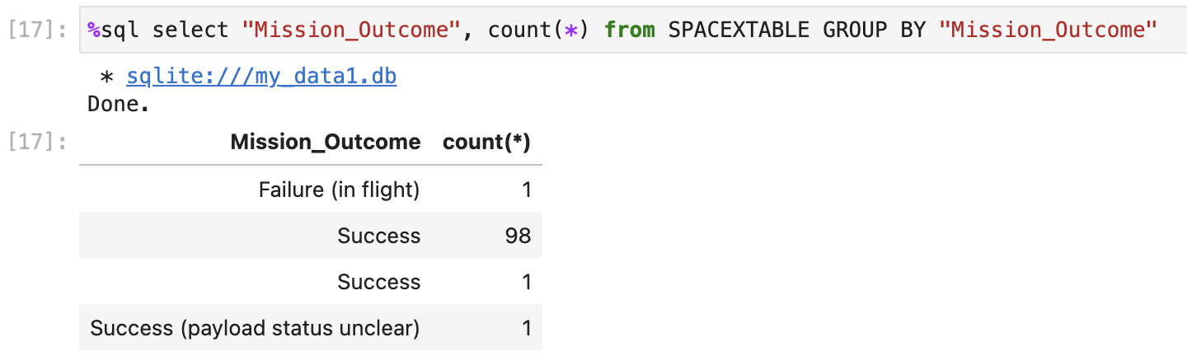
Total Number of Successful and Failure Mission Outcomes
The total number of Failure and Success of mission is given :-
Success = 98+1+1 = 100
Failure = 1

Slide 33
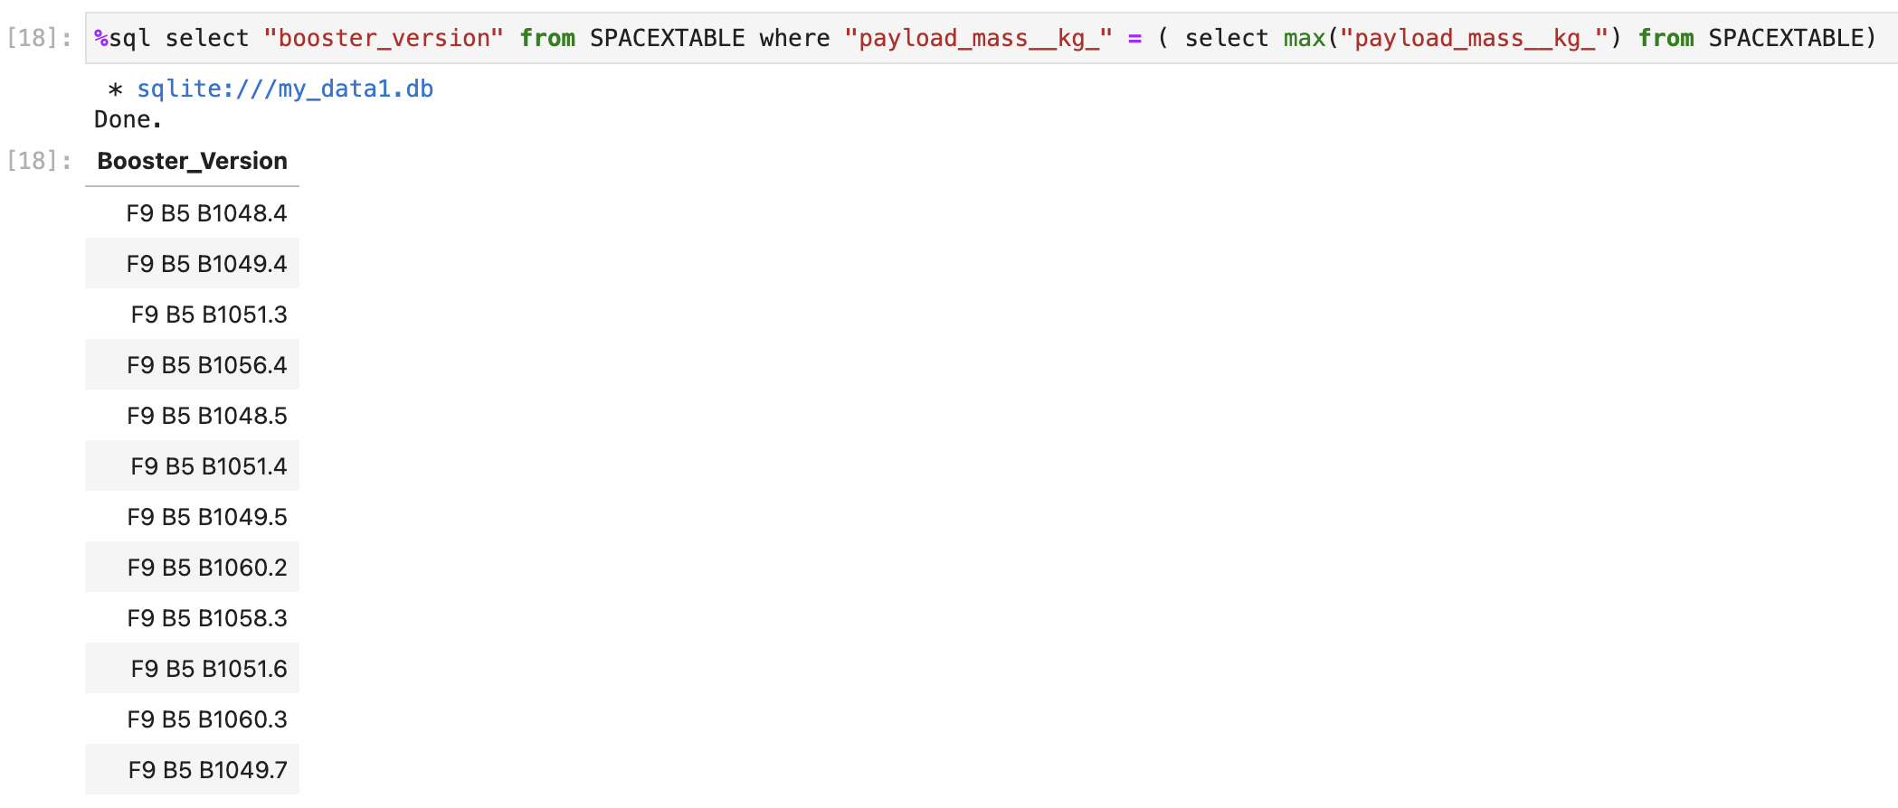
Boosters Carried Maximum Payload
These are the boosters which carry the maximum payload. All are variants of Falcon 9 heavy

Slide 34
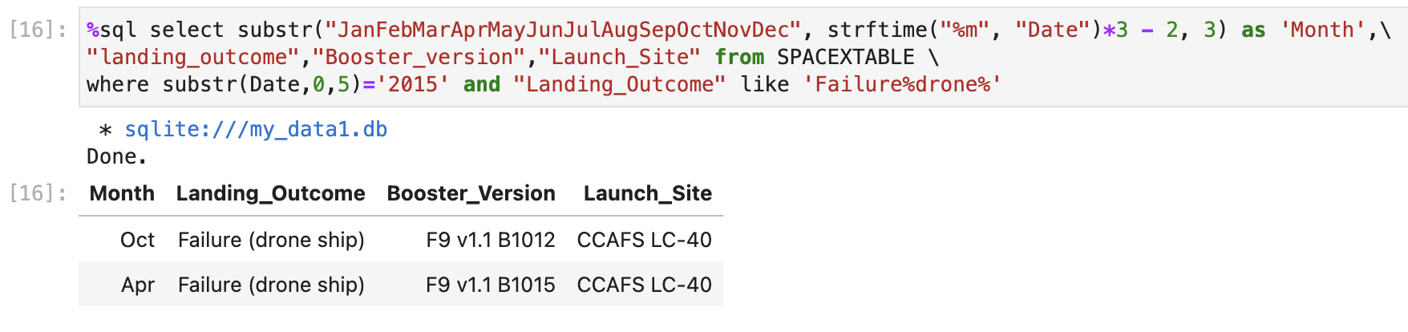
2015 Launch Records
We can list the failed landing outcomes, their booster versions and launch site names for a specific year, like 2015
Limitations of SQLite force us to use some string-based techniques to get the month name. A 3-letter month is obtained

Slide 35
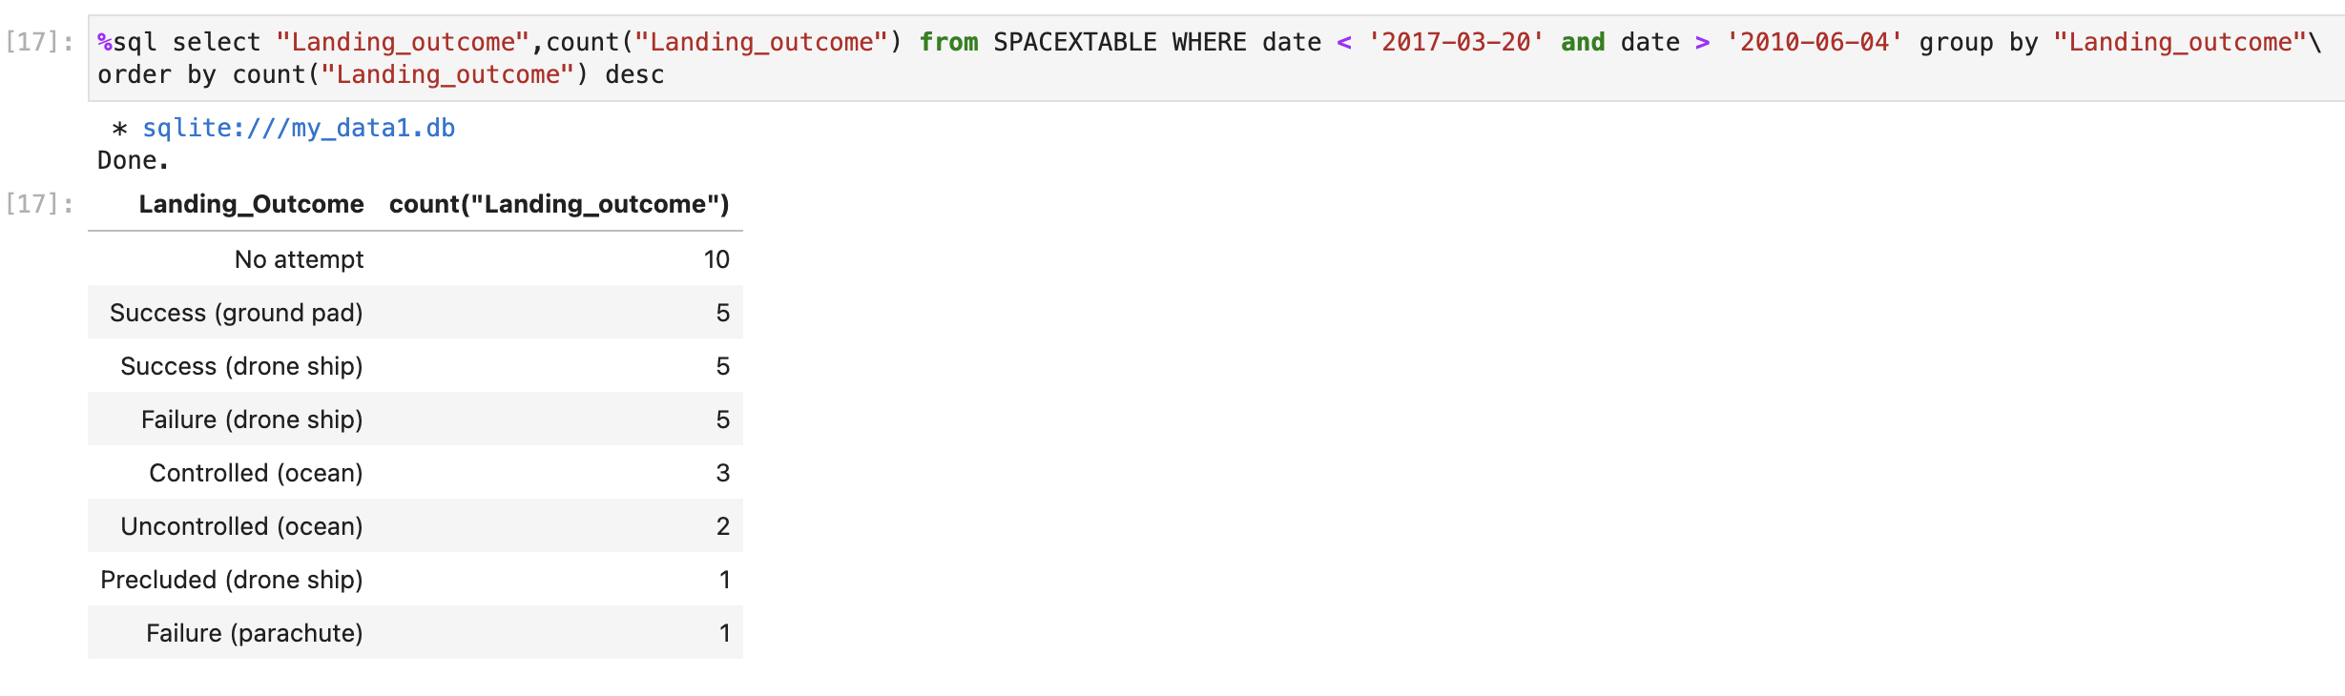
Rank Landing Outcomes Between 2010-06-04 and 2017-03-20
We can check the ranking of Landing Outcomes between 2010-06-04 and 2017-03-20, in descending order
We can see that no landing was attempted for 10 launching missions. 6 Failures have been noted, and 16 successful attempts

Slide 36

Section 3

Slide 37
Launch Sites
This map shows the position of the launch sites.
One site is on the west coast, while other three are on the east coast in Florida
The sites are close to the ocean
https://github.com/rsvinekar/Capstone-IBMDS/blob/main/folium_t1.html

Slide 38
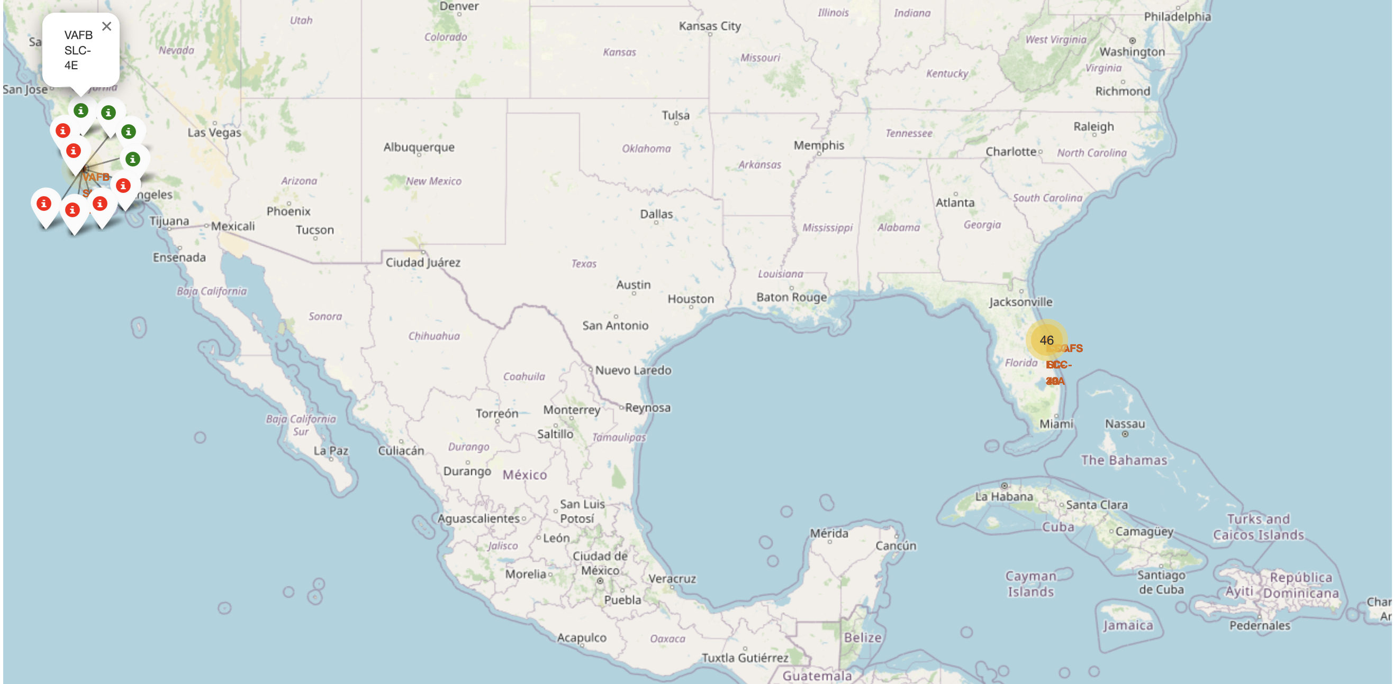
Launch Outcome
The map interactively shows positive launch outcomes with green markers and failed missions with red markers
The total number of missions launched are clustered near the site
https://github.com/rsvinekar/Capstone-IBMDS/blob/main/folium_t3.html

Slide 39
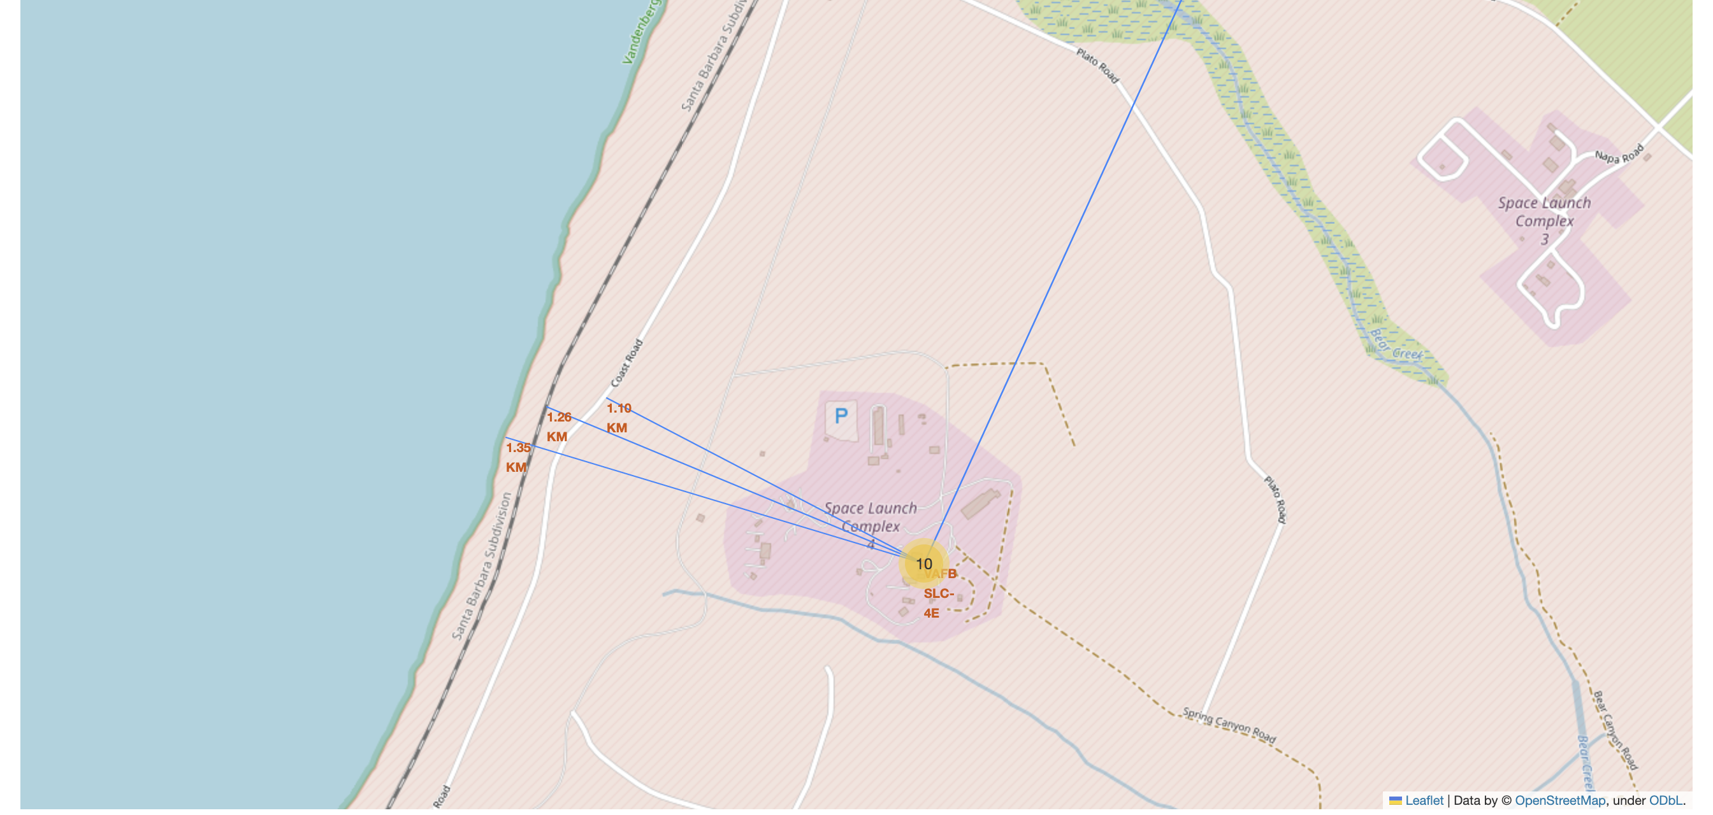
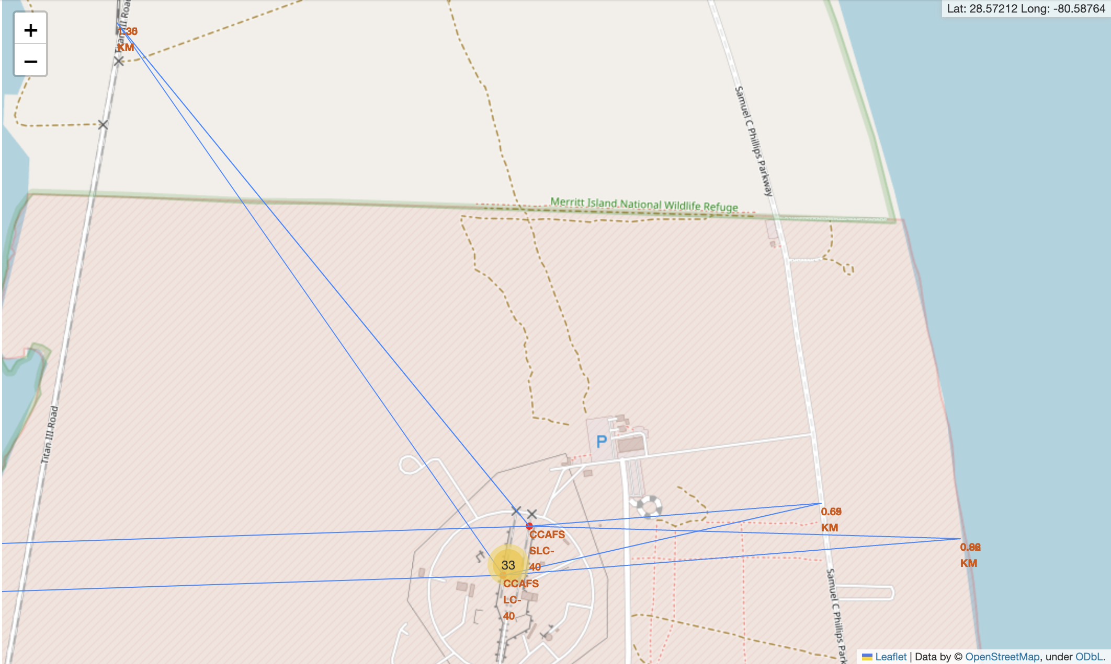
Launch Site proximity
The Launch sites are all close to the shoreline, and there are railway and road connections in its proximity
Large cities like Santa Maria on west coast (top) or Orlando in Florida (bottom) are much further away
These can be explained as follows:-
Launches go over the Ocean. Any failure can avoid populated areas
Rails and Roadways are close by, as logistics is required
Populated cities are far off, to minimize any casualties in case of failures
VAFB-SLC 4E is on the West Coast
https://github.com/rsvinekar/Capstone-IBMDS/blob/main/folium_t4.html
CCAFS-LC 40 and CCAFS-SLC 40 are in close proximity on east coast. KSC LC-39A is to the west of these (not seen here)

Slide 40

Section 4

Slide 41
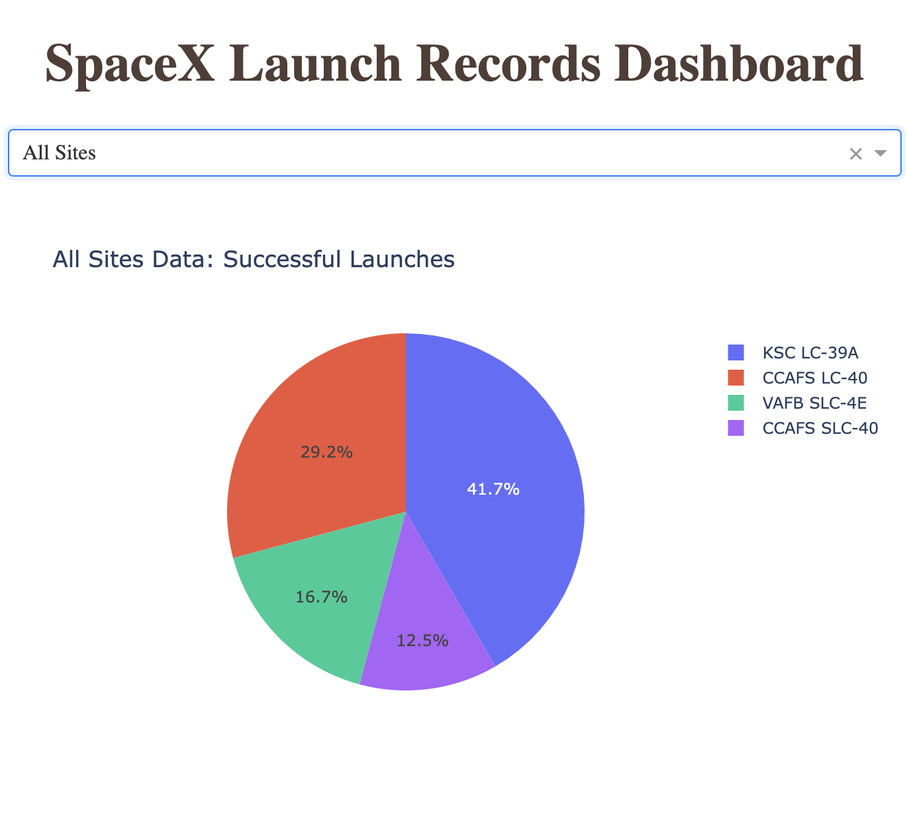
Successful Launches per site
The dashboard provides a dropdown which can choose “All Sites”
The Piechart shows KSC LC-39A having the highest success rate of 41.7%

Slide 42
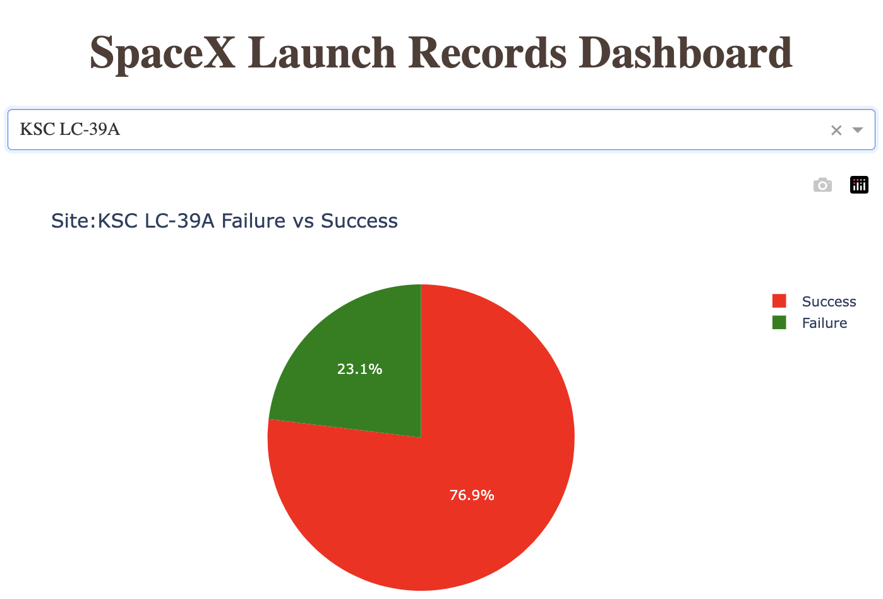
Success rate of the most productive launch site
The KSC LC-39A site shows the highest success rate compared to other sites
However, its actual success vs failure percentage is low : 23.1%
The CCAFS SLC-40 has a higher success rate of 42.9%
This is because KSC LC-39A has more launch attempts than CCAFS SLC-40

Slide 43
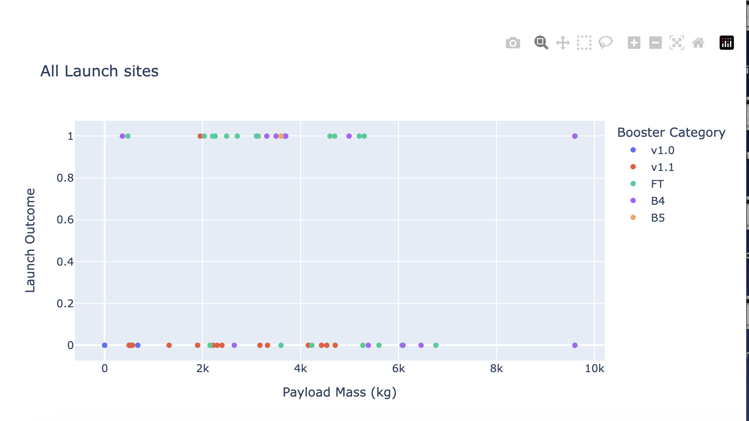
Dashboard Scatter plot
The Launch outcome is a binary quantity, 1 for success and 0 for failure
In the dashboard, we can get a scatter plot of Launch Outcome vs payload mass, colored by booster category
The plot shows that the FT Booster category has the higher success rate for payloads less than 6000 kg
The B4 Booster category works better at higher payloads
The booster payloads from 2000 kg and 6000 kg is most successful

Slide 44

Section 5

Slide 45
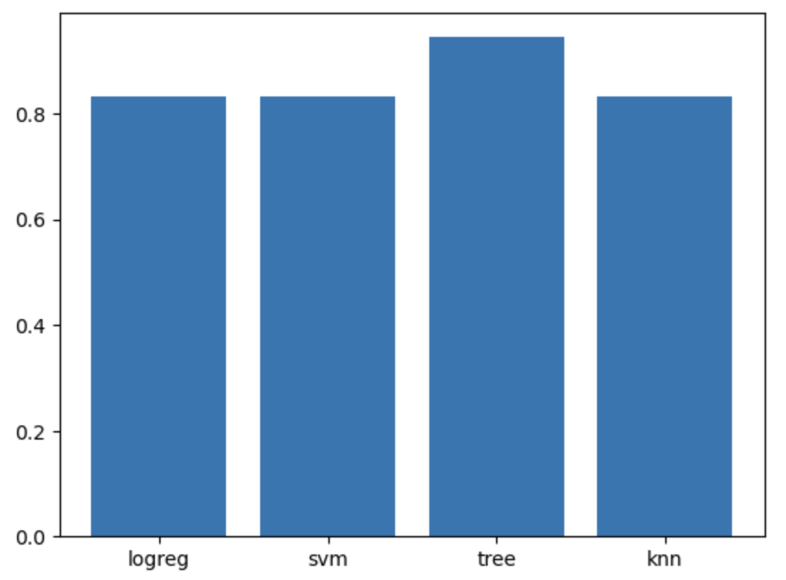
Classification Accuracy
A model has been built which can predict the landing outcome
Four models were tried:
logistic regression (logreg)
support vector machine (svm)
decision trees (tree)
K-nearest neighbours (knn)
The optimal parameters were determined using Grid Search Cross Validation (GridSearchCV)
The results show that the decision trees show the greatest accuracy score

Slide 46
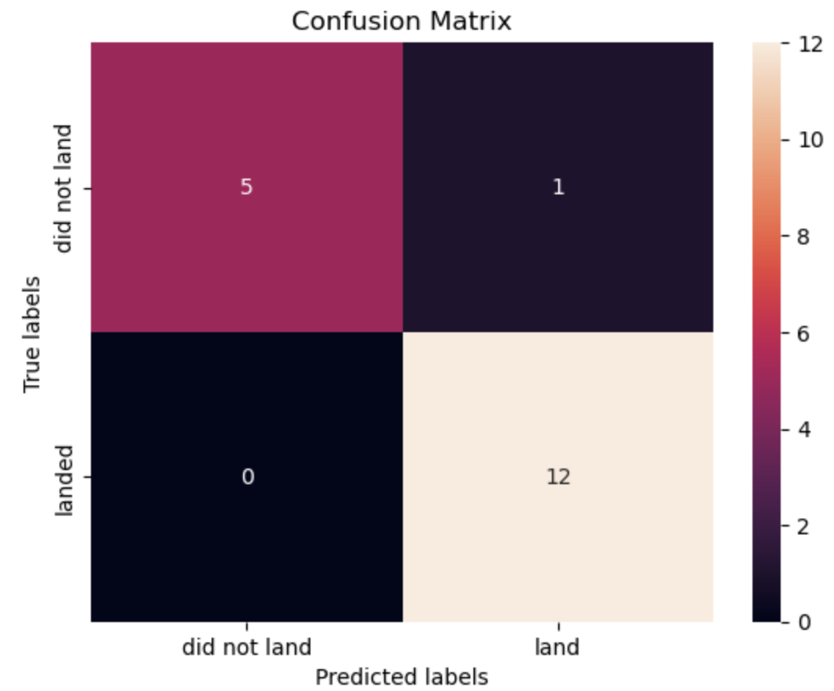
Confusion Matrix
The Decision tree model shows good predictions with the confusion matrix showing:-
1 False positive
5 True negatives
12 True positives
Thus, there is 1 undesirable result out of 18
This is a fairly good model, although it may do better with more data points

Slide 47

Conclusions
Data was obtained by REST API and web scraping on the launch status of SpaceX launches and specifications of the launchers
Exploratory data analysis gives us insights into the data, and maps can show the position of the launch sites and their proximity to coast, logistics infrastructure and distance from populated cities
Four different models for machine learning were used to predict the class variable from the other variables available to us. The best parameters were chosen using GridSearch cross validation for each
The decision tree model gave the best accuracy score of 0.86 and the confusion map seems acceptable. This ML model may be used for predictions on new data

Slide 48

Appendix
The GitHub repository for this work is : https://github.com/rsvinekar/Capstone-IBMDS
Two versions of the plotly dash application are provided, both give the same output
Dash1: https://github.com/rsvinekar/Capstone-IBMDS/blob/main/spacex_dash_app_dash1.py
Dash2: https://github.com/rsvinekar/Capstone-IBMDS/blob/main/spacex_dash_app_dash2.py
First is for dash 1.x as used in the Skills Network online. Second is for Dash 2.x installed on the latest Anaconda desktop. The latter is provided by default on Anaconda. To run the app, make sure dash is installed and then run
python spacex_dash_app_dash2.py
The difference is mainly in the import statements and slight changes elsewhere.

Slide 49


